Slide 1

332:479 Concepts in VLSI
Design
Lecture 7
Resistance and Capacitance Calculation for Transistors
Transistor Gate Capacitance
Transistor Drain Capacitance
Transistor Resistance
RC Delay Model
Summary
David Harris and Michael Bushnell
Harvey Mudd College and Rutgers University

Slide 2
Capacitance
Any two conductors separated by an insulator have capacitance
Gate to channel capacitor is very important
  Creates channel charge necessary for operation
Source and drain have capacitance to body
  Across reverse-biased diodes
  Called diffusion capacitance because it is associated with source/drain diffusion

Slide 3
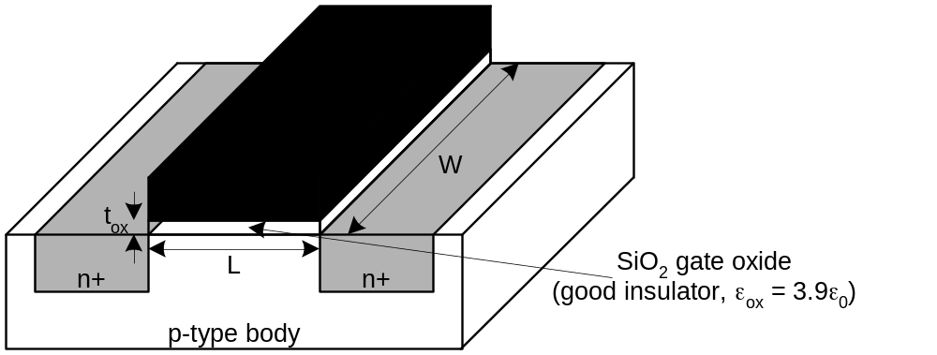
Gate Capacitance
Approximate channel as connected to source
C_{gs} = ε_{ox}WL/t_{ox} = C_{ox}WL = C_{permicron}W
C_{permicron} is typically about 2 fF/μm

Slide 4
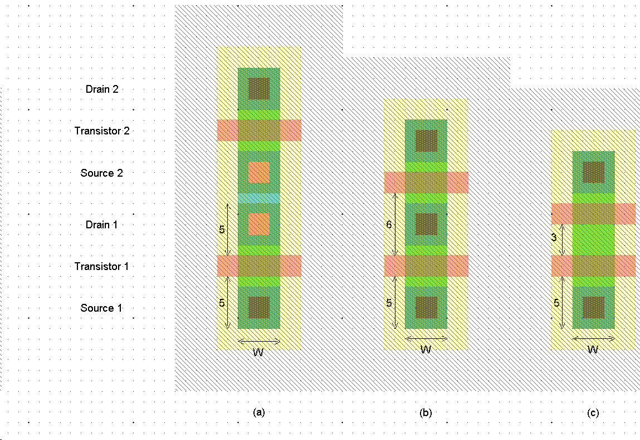
Diffusion Capacitance
C_{sb}, C_{db}
Undesirable, called parasitic capacitance
Capacitance depends on area and perimeter
  Use small diffusion nodes
  Comparable to C_{g}
  for contacted diff
  ½ C_{g} for uncontacted
  Varies with process

Slide 5
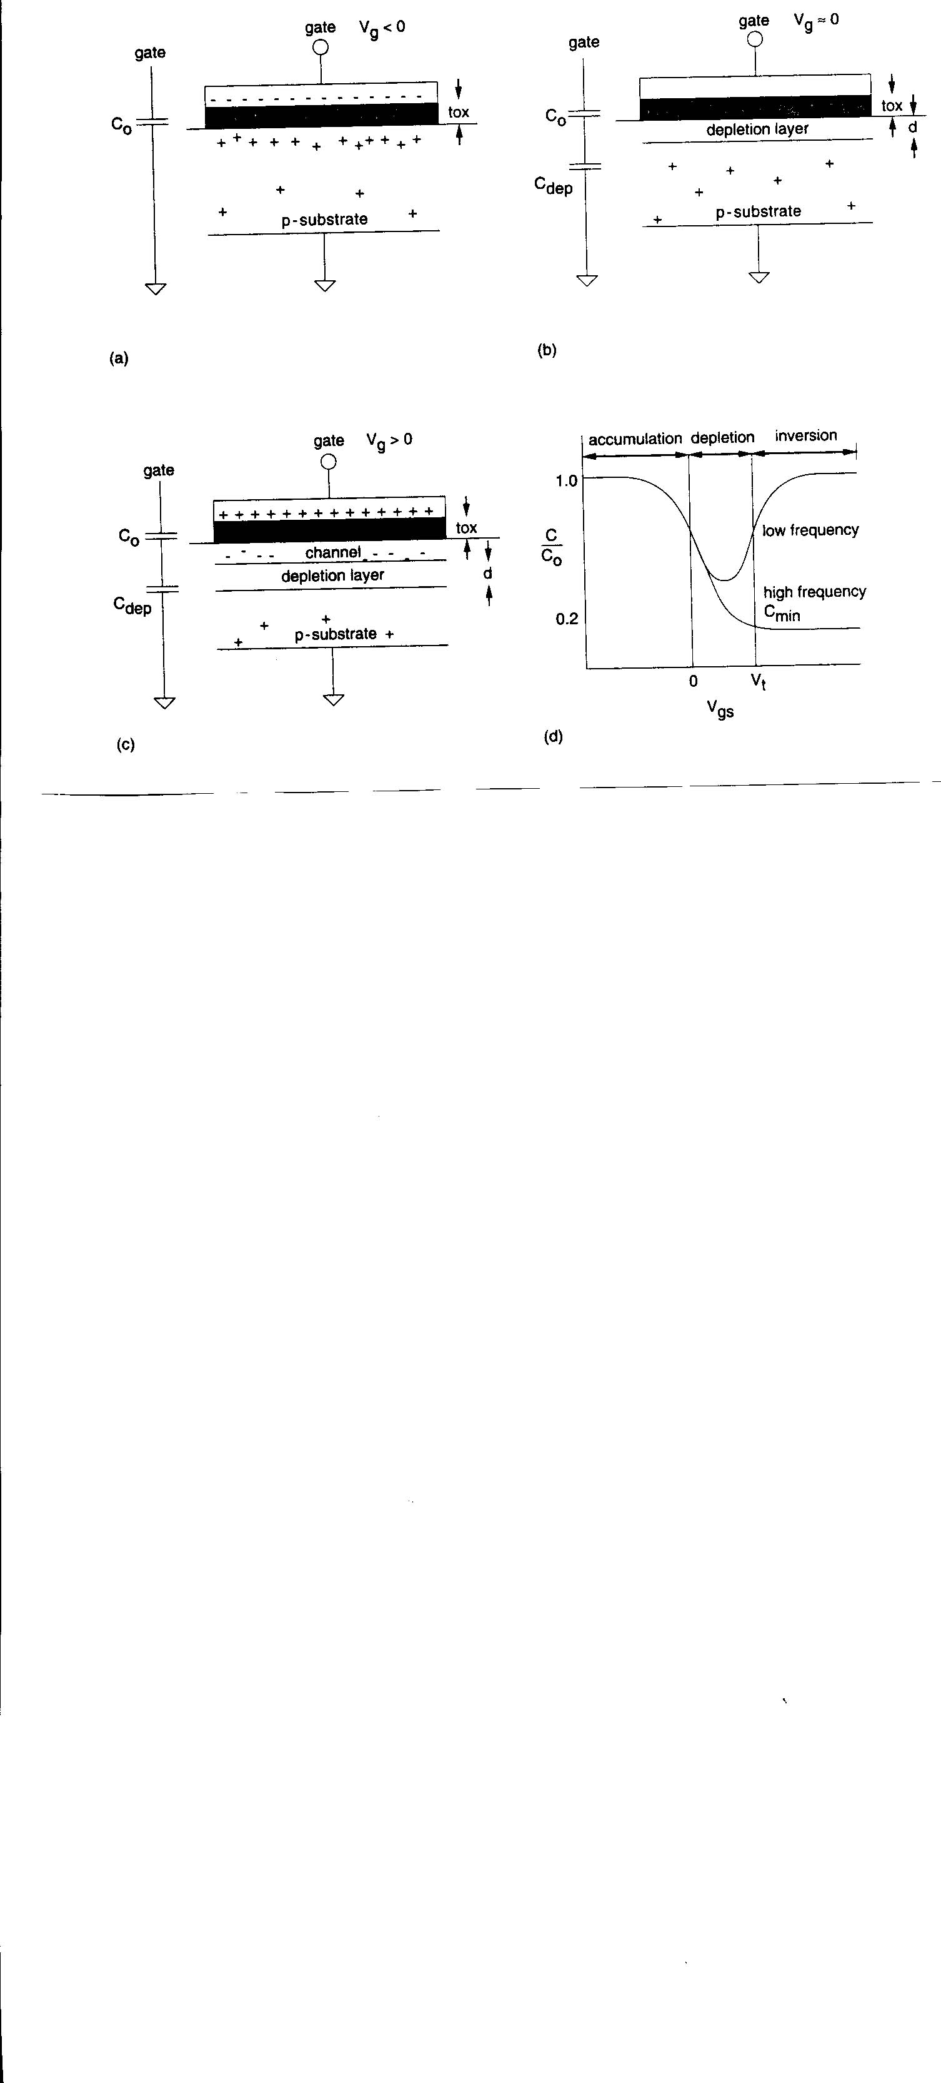
MOS Capacitor

Slide 6
MOS Capacitor

Slide 7
MOSFET Capacitances
Logic Gate load capacitance has 3 C’s in parallel between gate output & substrate:
  Transistor gate capacitance (of other gate inputs connected to this gate output)
  Diffusion capacitance of transistor drains connected to gate output
  Routing capacitance of wires connected to the output
Gate capacitance:
C₀ = ε_{SiO2} ε₀ A (gate area)
t_{ox}

Slide 8
MOSFET Capacitances (cont’d)
Depletion Capacitance:
C_{dep} = ε_{Si} ε₀ A, ε_{Si} = 12, d = depletion layer depth
d
Total C between gate & substrate = C_{gb}
C₀ in series with C_{dep}
C_{gb} = C₀ Accumulation Mode
C_{gb} = C₀ C_{dep} Depletion Mode
C₀ + C_{dep}

Slide 9
MOSFET Capacitances (cont’d)
In inversion, there is a limited supply of charge carriers to the inversion layer, so it cannot track rapid voltage changes.
Dynamic C is the same as for depletion
C_{gb} = C₀ {f < 100 Hz}
= C₀ C_{dep} = C_{min} {high f }
C₀ + C_{dep}

Slide 10
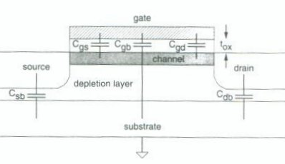
MOSFET Parasitic Capacitances

Slide 11
Capacitances
C_{gs}, C_{gd} = gate to channel capacitances, lumped at source & drain
C_{sb}, C_{db} = source & drain diffusion capacitances to bulk

Slide 12
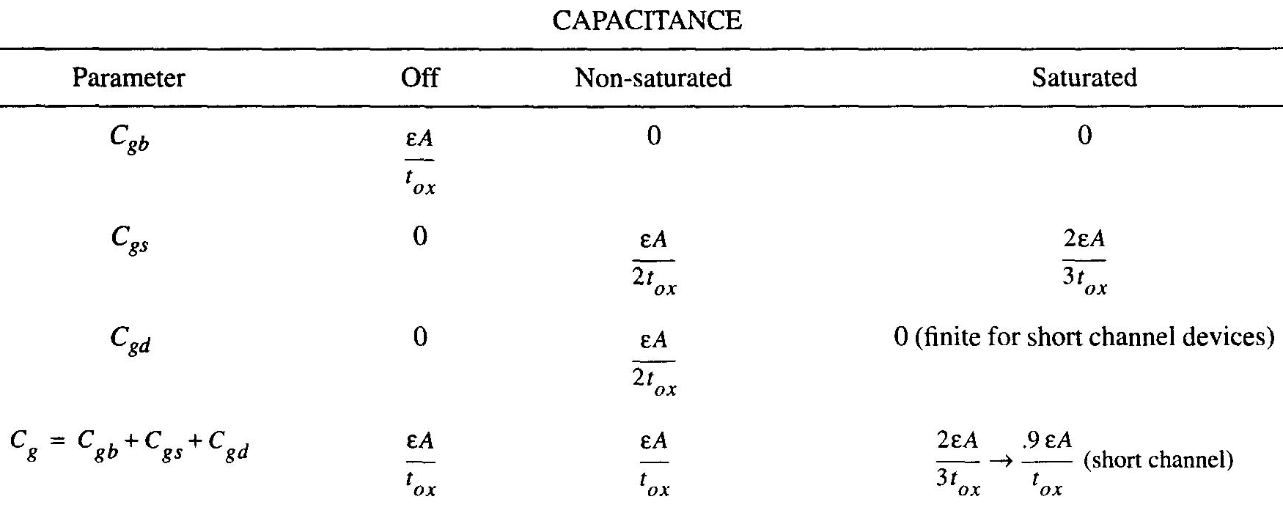
Approximation of Intrinsic MOS Capacitances

Slide 13
Capacitance Calculation
Off region, V_{gs} < V_{t}, no channel so C_{gs} = C_{gd} = 0
C_{gb} = C₀ C_{dep}
C₀ + C_{dep}
Non-saturated (linear) region V_{gs} = V_{t} V_{ds}
Constant depletion layer depth, channel forms, C_{gs}, C_{gd} become significant
C_{gd} = C_{gs} 1 ε₀ ε_{SiO2} A
2 t_{ox}
C_{gb} 0
(
)

Slide 14
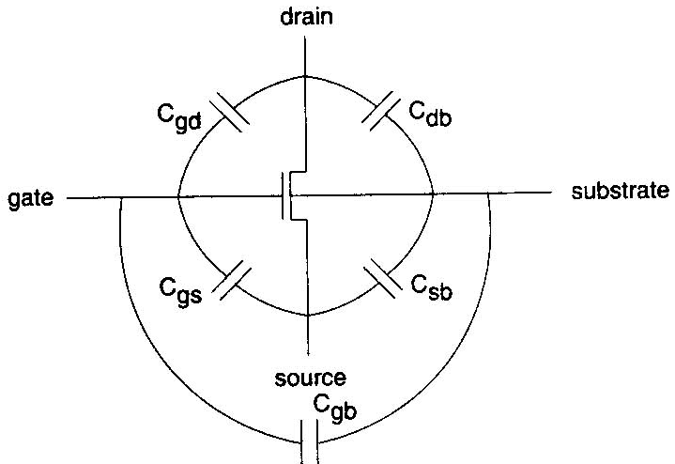
Capacitance Calculation (cont’d.)
Saturated region V_{gs} – V_{t} < V_{ds}
Channel heavily inverted, drain pinched off, C_{gd} = 0
C_{gs} = 2 ε₀ ε_{SiO2} A
3 t_{ox}
(
)

Slide 15
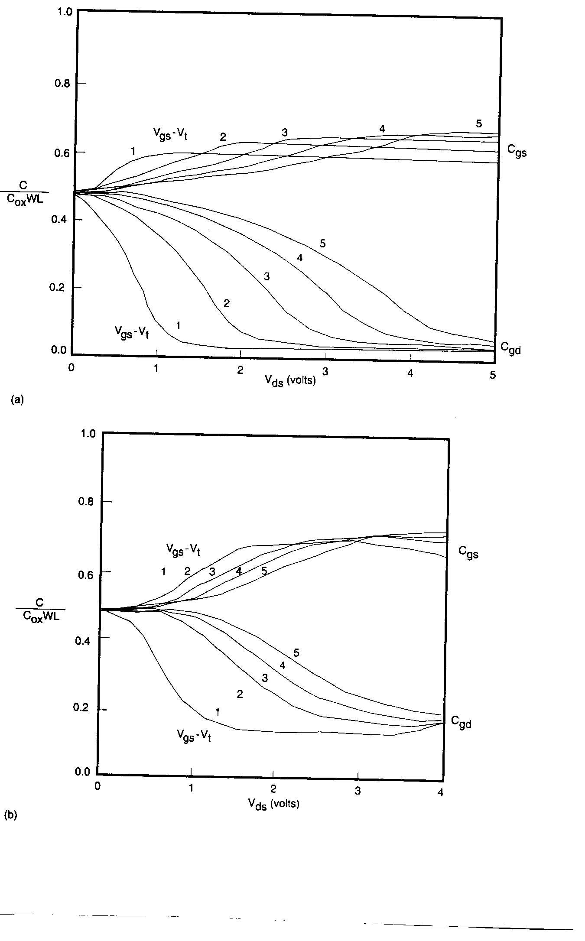
Long Channel C Variation

Slide 16
Short Channel C Variation

Slide 17
Saturation Capacitance
C_{gd} = finite in saturation due to channel side fringing fields between gate & drain
Approximate C_{g} as C₀ = C_{ox} A
C_{ox} = ε₀ ε_{SiO2}
t_{ox}

Slide 18
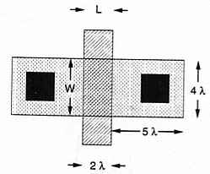
Calculation of C from Geometry
Unit Transistor
Diffusion Capacitance
  C_{d} = C_{ja} X (a b) + C_{jp} X (2a + 2b)
  C_{ja} = junction C per μm²
  C_{jp} = periphery C per μm
  a = diffusion width
  b = diffusion length

Slide 19
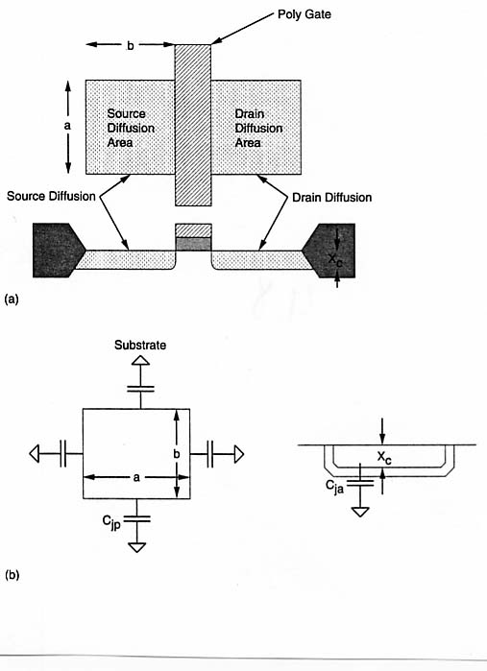
Capacitance in Transistor

Slide 20
C Dependence on Junction V
(
)
C_{j} = C_{j0} 1 – V_{j} ^{-m}
V_{b}
V_{j} = junction voltage (< 0 for reverse bias)
C_{j0} = zero bias C (V_{j} = 0)
V_{b} = built-in junction potential
m is constant, depends on impurity distribution near junction, and whether junction is bottom or side

Slide 21
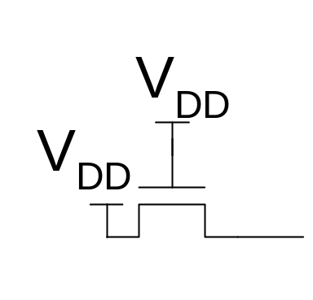
Pass Transistors
We have assumed source is grounded
What if source > 0?
  e.g. pass transistor passing V_{DD}

Slide 22
Pass Transistors
We have assumed source is grounded
What if source > 0?
  e.g. pass transistor passing V_{DD}
V_{g} = V_{DD}
  If V_{s} > V_{DD}-V_{t}, V_{gs} < V_{t}
  Hence transistor would turn itself off
nMOS pass transistors pull no higher than V_{DD}-V_{tn}
  Called a degraded “1”
  Approach degraded value slowly (low I_{ds})
pMOS pass transistors pull no lower than V_{tp}

Slide 23
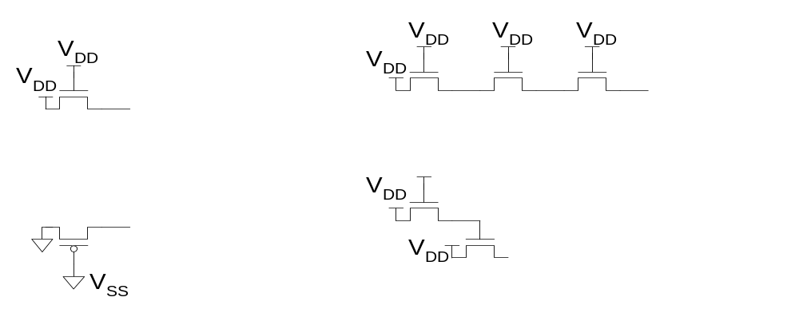
Pass Transistor Circuits

Slide 24
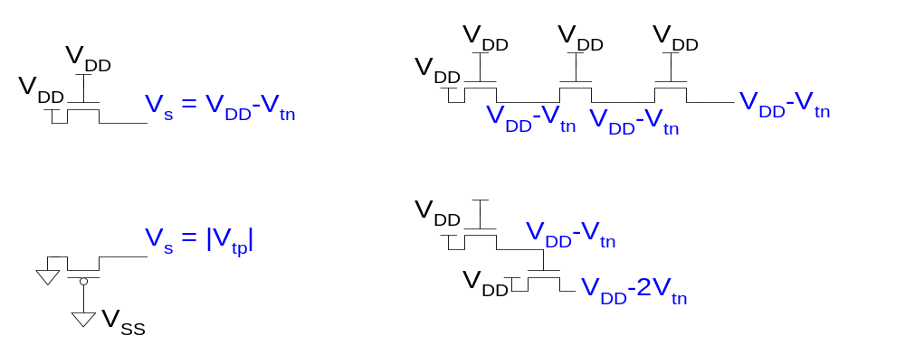
Pass Transistor Circuits

Slide 25
Effective Resistance
Shockley models have limited value
  Not accurate enough for modern transistors
  Too complicated for much hand analysis
Simplification: treat transistor as resistor
  Replace I_{ds}(V_{ds}, V_{gs}) with effective resistance R
    I_{ds} = V_{ds}/R
  R averaged across switching of digital gate
Too inaccurate to predict current at any given time
  But good enough to predict RC delay

Slide 26
MOSFET Channel Resistance
(
)
R_{c} = k L , k = 1
W μ C_{ox} (V_{gs} – V_{t})
C_{ox} = ε_{rSiO2} ε₀
t_{ox}

Slide 27
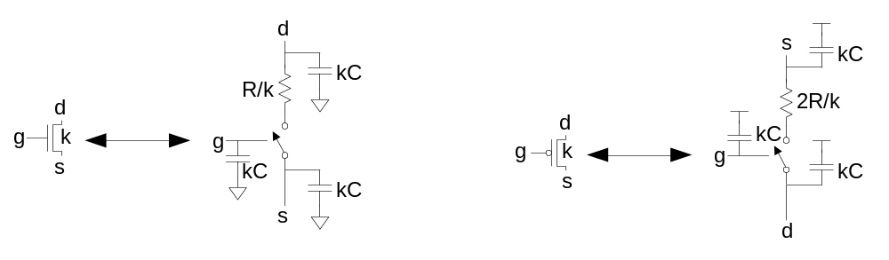
RC Delay Model
Use equivalent circuits for MOS transistors
  Ideal switch + capacitance and ON resistance
  Unit nMOS has resistance R, capacitance C
  Unit pMOS has resistance 2R, capacitance C
Capacitance proportional to width
Resistance inversely proportional to width

Slide 28
RC Values
Capacitance
  C = C_{g} = C_{s} = C_{d} = 2 fF/μm of gate width
  Values similar across many processes
Resistance
  R ≈ 6 KΩ*μm in 0.6um process
  Improves with shorter channel lengths
Unit transistors
  May refer to minimum contacted device (4/2 λ)
  Or maybe 1 μm wide device
  Doesn’t matter as long as you are consistent

Slide 29
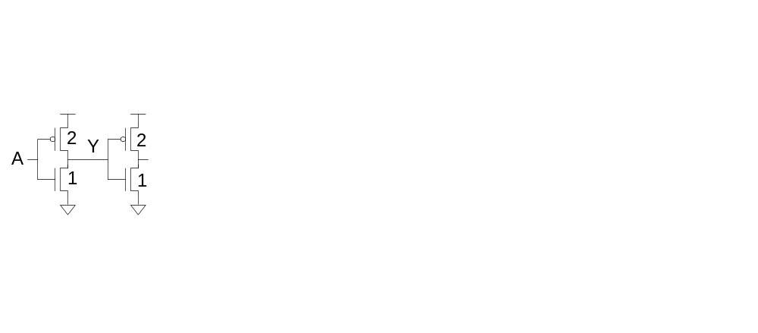
Inverter Delay Estimate
Estimate the delay of a fanout-of-1 inverter

Slide 30
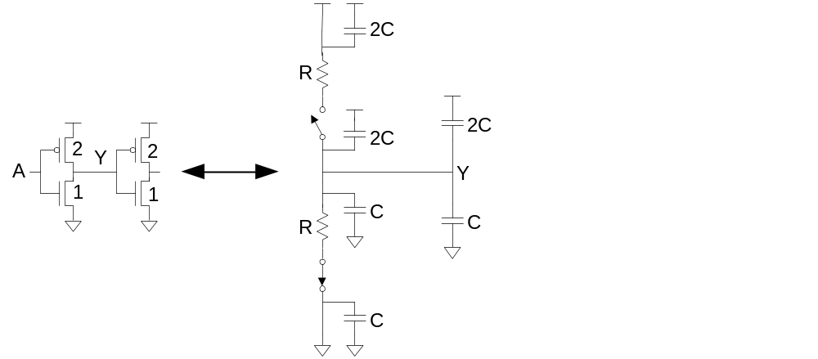
Inverter Delay Estimate
Estimate the delay of a fanout-of-1 inverter

Slide 31
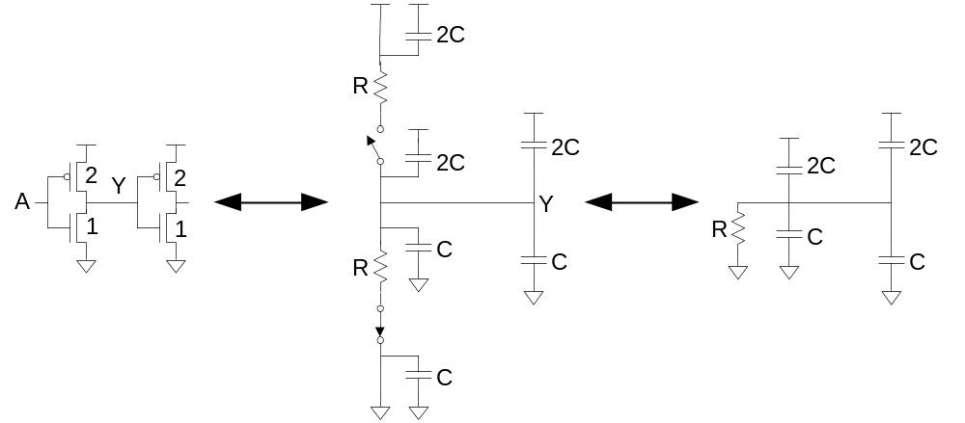
Inverter Delay Estimate
Estimate the delay of a fanout-of-1 inverter

Slide 32
Inverter Delay Estimate
Estimate the delay of a fanout-of-1 inverter
d = 6RC

Slide 33
Summary
Capacitance – critical for correct delay calculation
Transistor Gate Capacitance
Transistor Drain Capacitance
Transistor Resistance
RC Delay Model

